Slide 1


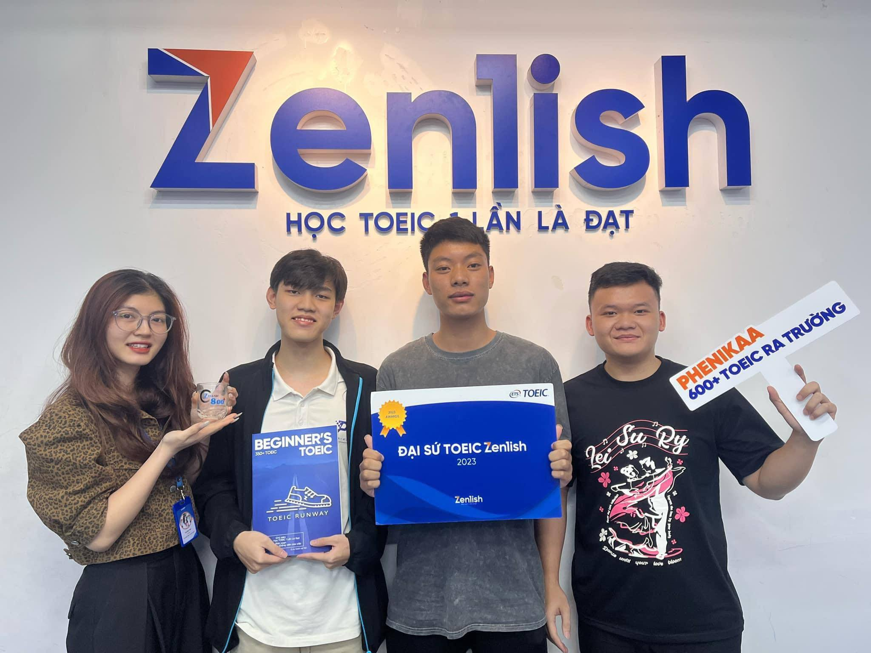
ZENLISH – HỌC TOEIC 1 LẦN LÀ ĐẠT
BEGINNER’S TOEIC
LESSON 11

Slide 2



ZENLISH – HỌC TOEIC 1 LẦN LÀ ĐẠT
BEGINNER’S TOEIC
LESSON 11
THỰC HÀNH PART 4 (2)

Slide 3


1
1
Where is the announcement being made?
(A) At an art supply store
(B) At a public library
(C) At a school
(D) At a hardware store
shoppers
M-Cn: Attention, ............................ ! Today is the first day of our spring ............... ............... . This is being held on the .............. ................ . All art supplies are now on sale, starting from as little as one dollar. We've got great deals on brushes, canvases, paint, and more! Also, from now until August thirtieth, we're .............................. .............................. for our summer art ....................... ! This is a wonderful opportunity for aspiring artists to get their work shown. Please visit the ...................... ........................ for details. Thank you for shopping at Baxter's Art Supply Store.
sales event
first floor
2
What can listeners find on the first floor?
(A) A product demonstration
(B) A discussion-group meeting
(C) Refreshments
(D) Items on sale
accepting submissions
contest
3
information desk
What are listeners encouraged to do by August 30?
(A) Activate a rewards card
(B) Enter a contest
(C) Register for a class
(D) Fill out surveys

Slide 4

VOCABULARY
art supply store /ɑːrt səˈplaɪ stɔːr/ - cửa hàng bán dụng cụ mỹ thuật
hardware store /ˈhɑːrd.wer stɔːr/ - cửa hàng bán đồ kim khí, dụng cụ sửa chữa
product demonstration /ˈprɑː.dʌkt ˌdem.ən.streɪ.ʃən/ - buổi giới thiệu sản phẩm
refreshments /rɪˈfreʃ.mənts/ - đồ ăn nhẹ, nước giải khát
activate /ˈæk.tə.veɪt/ - kích hoạt
survey /ˈsɝː.veɪ/ - khảo sát
submission /səbˈmɪʃ.ən/ - sự nộp, sự đệ trình
opportunity /ˌɑː.pɚˈtuː.nə.t̬i/ - cơ hội
aspiring /əˈspaɪr.ɪŋ/ - đầy tham vọng, khát vọng thành công

Slide 5
1
2
Who most likely is the speaker?
(A) An appliance salesperson
(B) A repair technician
(C) An apartment manager
(D) A hotel receptionist
W-Am: Hi, Armand, this is Linda from the ....................... …................... of Redfox Apartments. I received your message about your .............................. .............. ............... .............., so I've called a ...................... person to come and fix it on Monday morning at eleven o'clock. Since you'll probably be .................. at that time, could you please stop by the management office before then? You'll need to leave a .................. .................. .................. for the repair person to enter in your absence.
management office
2
dishwasher
not working properly
repair
What is the speaker calling about?
(A) An advertised rebate
(B) An expired warranty
(C) An inaccessible parking space
(D) A broken appliance
at work
3
letter giving permission
Why is the listener asked to stop by an office?
(A) To return a key
(B) To collect a package
(C) To drop off a letter
(D) To make a payment

Slide 6
VOCABULARY
appliance salesperson /əˈplaɪ.əns ˈseɪlzˌpɝː.sən/ - nhân viên bán hàng đồ gia dụng
advertised rebate /ˈæd.vɚ.taɪzd ˈriː.beɪt/ - khoản giảm giá được quảng cáo
expired warranty /ɪkˈspaɪrd ˈwɔːr.ən.t̬i/ - bảo hành đã hết hạn
inaccessible parking space /ˌɪn.əkˈses.ə.bəl ˈpɑːr.kɪŋ speɪs/ - chỗ đỗ xe không thể tiếp cận được
drop off /drɑːp ɔːf/ - thả xuống, gửi (hàng, người, đồ vật)
dishwasher /ˈdɪʃˌwɑː.ʃɚ/ - máy rửa bát
properly /ˈprɑː.pɚ.li/ - một cách đúng đắn, hợp lý
permission /pɚˈmɪʃ.ən/ - sự cho phép
absence /ˈæb.səns/ - sự vắng mặt

Slide 7
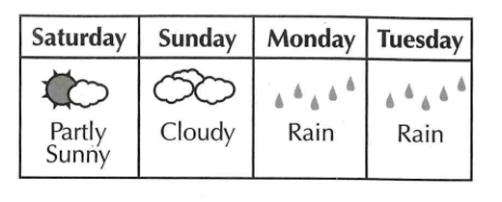
3
W-Am: And now, an event we've all been waiting for since last year—Danville’s ....................... ........................... Held outside at City Park, the Cook-Off always attracts a lot of participants. Competitors .................... ............ ........................, which they serve throughout the day. A panel of judges will select the winners based on taste, presentation, and uniqueness. This event is great fun for the whole family, and entry and food samples are free! If you're interested in participating, the contest .................................. form is available on the city's Website.
Now, keep in mind we're expecting .......... ................ ............. for this year's event. We won't see ............... ............................, so be sure to bring a jacket!
Annual Cook- Off
1
What event is being described?
A. A sports competition
B. A government ceremony
C. A music festival
D. A cooking contest
prepare one dish
2
According to the speaker, what can the listeners find on a Web site?
A. A city map
B. A list of vendors
C. A demonstration video
D. An entry form
registration
a cloudy day
3
Look at the graphic. Which day is the event being held?
any sunshine
A. Saturday
B. Sunday
C. Monday
D. Tuesday

Slide 8
VOCABULARY
cook-off /ˈkʊk.ɑːf/ - cuộc thi nấu ăn
participant /pɑːrˈtɪ.sə.pənt/ - người tham gia
competitor /kəmˈpet̬.ə.t̬ɚ/ - đối thủ, người cạnh tranh
throughout /θruːˈaʊt/ - khắp, xuyên suốt
a panel of judges /ə ˈpæn.əl əv ˈdʒʌdʒ.ɪz/ - ban giám khảo
registration form /ˌredʒ.ɪˈstreɪ.ʃən fɔːrm/ - đơn đăng ký
keep in mind /kiːp ɪn maɪnd/ - lưu ý, ghi nhớ
sunshine /ˈsʌn.ʃaɪn/ - ánh nắng
describe /dɪˈskraɪb/ - mô tả
vendor /ˈven.dɚ/ - người bán hàng, nhà cung cấp

Slide 9
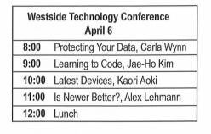
4
M-Cn: This is Seung-ho Park from Park Investors. We met last month at the Westside Technology Conference. I attended ..................... ...................... .......................... and spoke to you afterward about my small investment firm. I'm calling because I'd like to ................ ................ to discuss ways to make my company’s ......................... more secure. I know you specialize in this type of work, and I'm hoping you'll be interested in this project. Could you please e-mail me a list of ................. ............................ ....................? Use the ................................ .......................... on the business card I gave you. Thanks.
1
What is the purpose of the call?
your interesting presentation
A. To confirm a deadline
B. To explain a company policy
C. To make a job offer
D. To discuss a new product
hire you
database
2
Look at the graphic. Who is the speaker calling?
A. Carla Wynn
B. Jae-Ho Kim
C. Kaori Aoki
D. Alex Lehmann
your consultant fees
e-mail address
3
What does the speaker ask the listener to do?
A. Check a catalog
B. Send fee information
C. Submit a travel itinerary
D. Update a conference schedule

Slide 10
VOCABULARY
afterward /ˈæf.tɚ.wɚd/ - sau đó
investment /ɪnˈvest.mənt/ - sự đầu tư
secure /sɪˈkjʊr/ - an tâm, an toàn
specialize /ˈspeʃ.ə.laɪz/ - chuyên về
consultant /kənˈsʌl.tənt/ - cố vấn, người tư vấn
business card /ˈbɪz.nɪs kɑːrd/ - danh thiếp
catalog /ˈkæt̬.əl.ɔːɡ/ - danh mục
itinerary /aɪˈtɪn.ə.rer.i/ - lịch trình
conference /ˈkɑːn.fɚ.əns/ - hội nghị

Slide 11
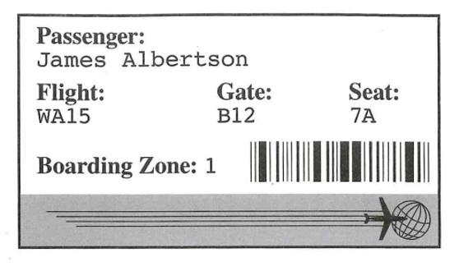
5
M-Au: Attention all passengers on Flight WA15. Due to .................... .................... , this flight has .................. .................. . We're very sorry for the inconvenience. In order to assist you in making alternative ….................... ………................ , we'll be calling passengers up to the counter according to your .................. .................. .................. . Please take out your boarding passes and ......... ......... the zone number you have been assigned. Approach the counter only when we call the group with your zone number. In just a few moments, we will begin unloading your luggage. Please listen for a separate .................... ..................... ..................... to retrieve your ............... . Thank you for your ......................... and cooperation.
inclement weather
been canceled
1
What is the announcement about?
(A) Connecting flight information
(B) A lost item
(C) A flight cancellation
(D) A gate change
travel arrangements
boarding zone numbers
2
Look at the graphic. Which number should James Albertson pay attention to now?
look at
(A) WA15
(B) B12
(C) 7A
(D) 1
announcement about where
3
bags
patience
What will the speaker announce later?
(A) Where to find luggage
(B) How to select a new seat
(C) Whom to contact for a refund
(D) When repairs will be finished

Slide 12
VOCABULARY
connecting flight /kəˈnek.tɪŋ flaɪt/ - chuyến bay nối tiếp
cancellation /ˌkæn.səlˈeɪ.ʃən/ - sự hủy bỏ
inclement weather /ɪnˈklem.ənt ˈweð.ɚ/ - thời tiết khắc nghiệt
alternative /ɑːlˈtɝː.nə.t̬ɪv/ - phương án thay thế
travel arrangement /ˈtræv.əl əˈreɪndʒ.mənt/ - sự sắp xếp chuyến đi
boarding zone /ˈbɔːr.dɪŋ zoʊn/ - khu vực lên máy bay
approach /əˈproʊtʃ/ - tiếp cận, đến gần
announcement /əˈnaʊns.mənt/ - thông báo
patience /ˈpeɪ.ʃəns/ - sự kiên nhẫn
cooperation /koʊˌɑː.pəˈreɪ.ʃən/ - sự hợp tác

Slide 13
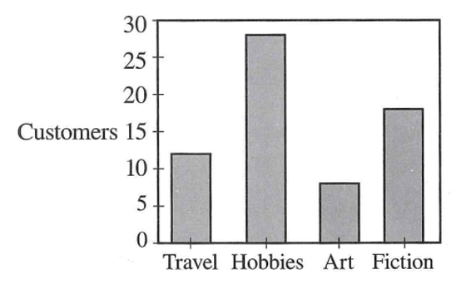
6
retreat
W-Br: Last week I went to the yearly .................. for Kierson Bookstore ..................... The good news coming out of that meeting concerns .................. . Each store in the chain will have an increased .................. next year to ................ ................ ............... one of the sections in their store. After I returned, I took an informal ................ ................ what kind of books customers would like us to carry more of. As you can see from the chart, it's clear which one they .......... ............ ............ And the ................ ................ will need to be ….................. , unfortunately. That inventory has become too expensive to stock.
managers
1
What event did the speaker recently attend?
money
(A) An advertising seminar
(B) An awards ceremony
(C) A managers’ meeting
(D) A writing workshop
budget
spend on expanding
2
What topic does the speaker report on?
survey about
(A) Company finances
(B) Human resources
(C) Advertising
(D) Competitors
like the best
art section
reduced
3
Look at the graphic. Which store section will be expanded?
(A) Travel
(B) Hobbies
(C) Art
(D) Fiction

Slide 14
VOCABULARY
advertising seminar /ˈæd.vɚ.taɪ.zɪŋ ˈsɛm.ə.nɑːr/ - hội thảo quảng cáo
awards ceremony /əˈwɔːrdz ˈser.ə.moʊ.ni/ - lễ trao giải
retreat /rɪˈtriːt/ - chuyến nghỉ dưỡng, buổi tập huấn xa
section /ˈsek.ʃən/ - phần, khu vực, mục
survey /ˈsɝː.veɪ/ - cuộc khảo sát
unfortunately /ʌnˈfɔːr.tʃən.ət.li/ - thật không may
inventory /ˈɪn.vən.tɔːr.i/ - hàng tồn kho, bảng kiểm kê

Slide 15
THANK YOU

